Slide 1
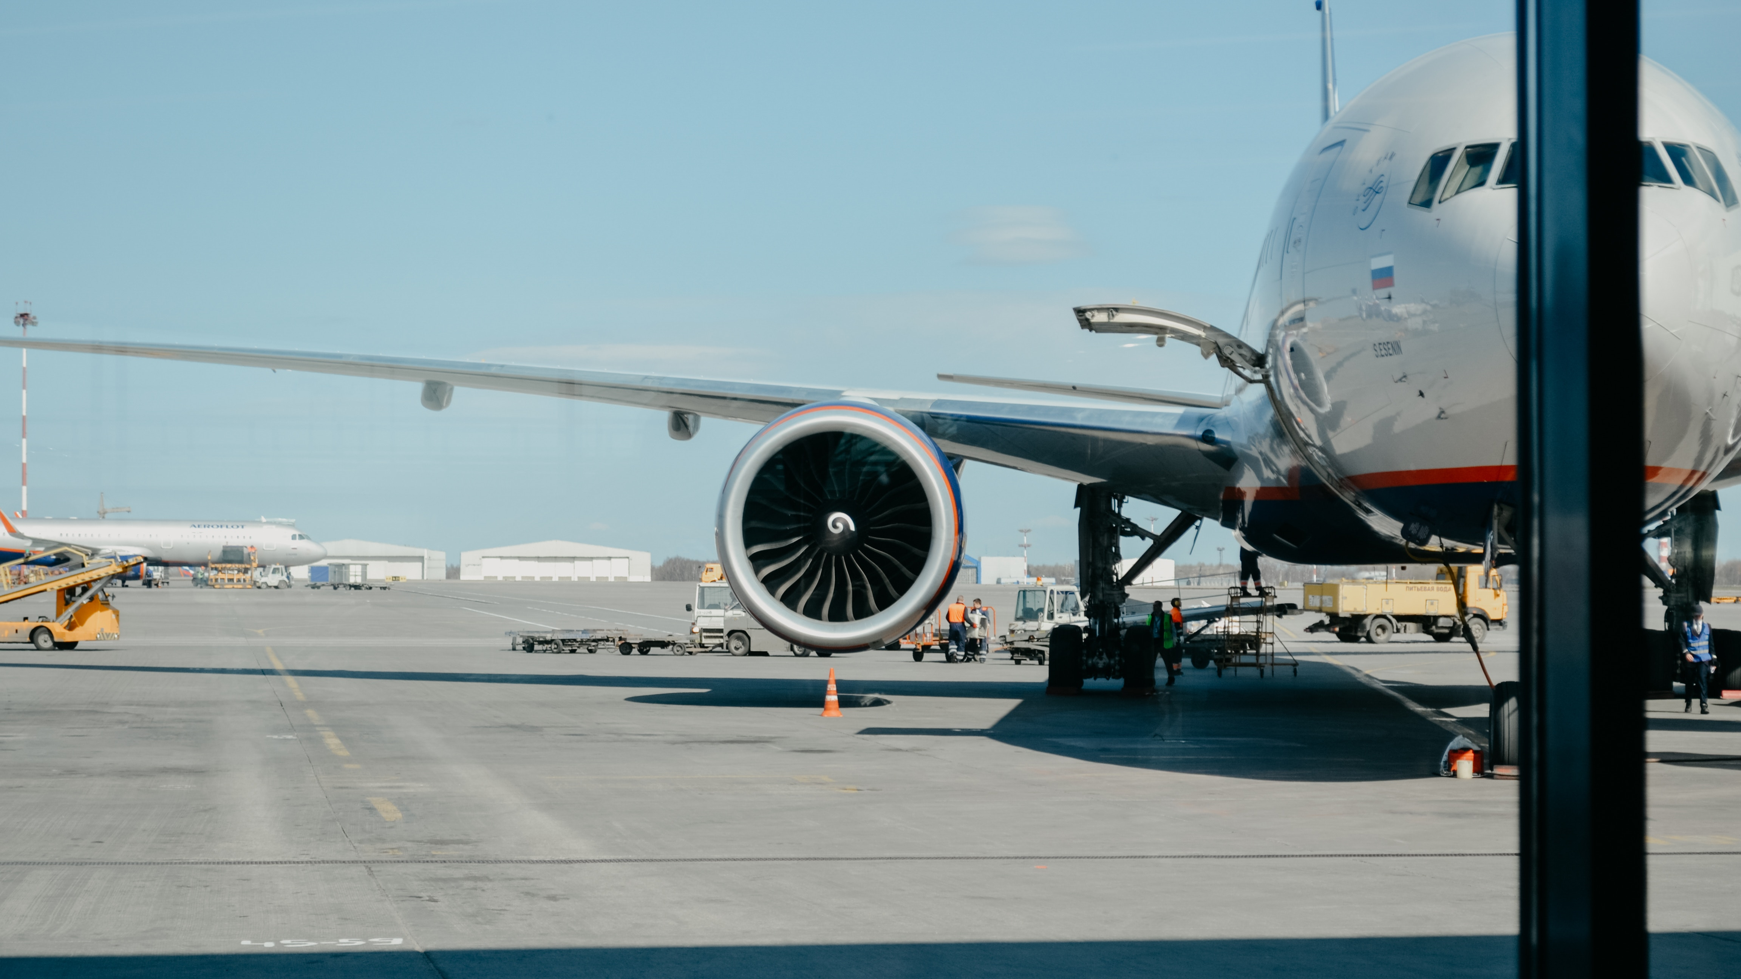
Flight Delays Analysis & Predictions
DATA 603 Platforms for Big Data Processing
SPRING 2023 ,UMBC
Notes:
Creadit picture :
Unsplash
Iwan Shimko
@iwnph
Link : https://unsplash.com/photos/tCp2K2sYpFg

Slide 2
SRIKAR NIKHIL VANAMA
MEGHNA ARYASRI
RAHUL MALLELA
TEAM MEMBERS
Notes:
Creadit picture :
Unsplash
Iwan Shimko
@iwnph
Link : https://unsplash.com/photos/tCp2K2sYpFg

Slide 3
AGENDA
Flight Delays Analysis & Predications using Big Data Tools
INTRODUCTION
Project Idea & Goals
About the Data
STRATEGY & PLAN
Technology Stack Proposed Plan
IMPLEMENTATION & OUTCOMES
Visualizations & Results
Key Learnings

Slide 4
INTRODUCTION
Airline industry has played a significant role in the growth of globalization by making it easier and faster for people to travel.
The cost of flight delays to the airline industry and the economy can be significant. According to a report by the Federal Aviation Administration (FAA), flight delays in the United States alone cost the economy an estimated $32.9 billion in 2019.
So, there is a need to analyze flight delays to find the root causes of delays and take steps to reduce them, which can lead to cost savings.

Slide 5
PROJECT GOALS
The goal of the project is to use the historical flight data to predict the future possible delays for airlines and airports .
Use Big data tools as required.
Use atleast 20 airports data in USA from over 10 years.
Visualize the data for insights.

Slide 6
ABOUT THE DATA
Using the data from harvard.edu which consists of flight arrival and departure details for all commercial flights within the USA.
Large dataset with about 120 million records(before filtering the required airports)
Some important columns: Scheduled Departure Time, Actual Departure Time, Scheduled Arrival Time, Actual Arrival Time

Slide 7
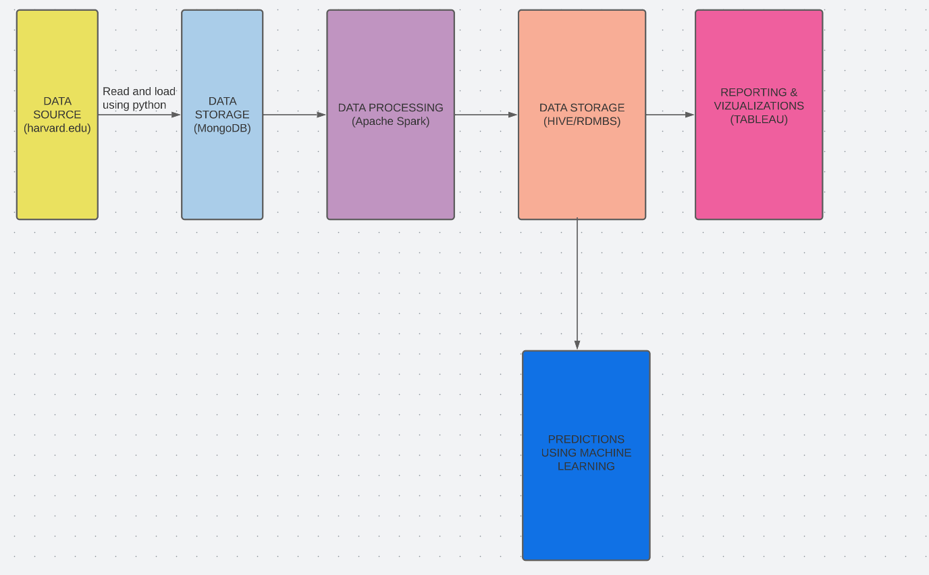
WORKFLOW/TECHNOLOGY STACK

Slide 8
PROPOSED PLAN
Data will be taken from harvard.edu.
The obtained data is read through python and is ingested into MongoDB
Data Stored in MongoDB is then Processed using Apache Spark.
Processed data is then stored into Apache Hive or RDBMS for further analysis.
Tableau will be used to present interactive dashboards and create stories.
Machine Learning algorithms such as Logistic regression, random forest and SVM can be used on cleaned data for predictions.

Slide 9
VISUALIZATIONS
Some of the Visualizations that will be presented using tableau:
Charts with historical data
Airports with largest number of departure and arrival flights
Most delayed airlines and airports based on historical data and using the predicted data.
And many more…

Slide 10
KEY LEARNINGS
Use of Big Data tools including Apache Spark, MongoDB.
Story telling using Tableau.
Use of different machine learning algorithms.
ETL techniques.
Data Cleaning and Processing.
Data Management on SQL and NoSQL databases.

Slide 11
REFERENCES
https://www.scnsoft.com/analytics/big-data/implementation
https://dataverse.harvard.edu/dataset.xhtml?persistentId=doi:10.7910/DVN/HG7NV7
https://transtats.bts.gov/databases.asp?20=E&Z1qr_VQ=E&Z1qr_Qr5p=N8vn6v10&f7owrp6_VQF=D
https://www.infoworld.com/article/3236869/what-is-apache-spark-the-big-data-platform-that-crushed-hadoop.html

Slide 12
THANK YOU

